Slide 1

BRAND REPUTATION ANALYTICS
SENTIMENT REPUTATION BUSINESS MONITORING

Slide 2

Agenda
Introduction
Business Problem
Project Objective
Dashboard Overview
Key Insight
Recommendations

Slide 3


INTRODUCTION
AfriTech Electronics Ltd. is a global leader in innovative consumer electronics, specializing in high-performance smartphones, tablets, and wearables. Headquartered in the U.S. and powered by a dedicated team of 200, we achieved $2M in FY2022 revenue through a relentless focus on cutting-edge technology and quality. Today, AfriTech is recognized as a trusted, high-growth brand positioned at the forefront of international market trends.

Slide 4

BUSINESS PROBLEM
Erosion of Trust: Surge in negative social media sentiment and high-profile product recalls have damaged brand equity.
Operational Friction: Rising complaints regarding product defects and support delays are lowering Customer Satisfaction (CSAT).
Market Vulnerability: Competitors are actively leveraging our reputation challenges to capture market share.
Financial Impact: Declining trust is translating directly into lost sales and reduced market presence.

Slide 5


PROJECT OBJECTIVES
Protect Market Position by monitoring brand visibility and competitor activity across social media platforms.
Improve Customer Retention through analysis of product recalls, crisis resolution outcomes, and response efficiency.
Enable Crisis Mitigation by identifying patterns in negative sentiment and recall-related reputational risk.
Support Data-Driven Decision-Making through the development of actionable KPIs and interactive dashboards.
Enhance Marketing Effectiveness by analyzing platform-level engagement, sentiment trends, and influencer impact.

Slide 6
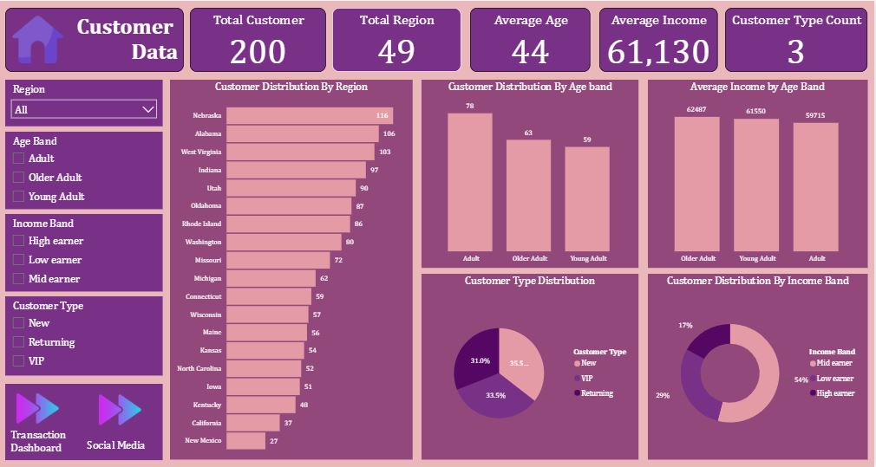
DASHBOARD OVERVIEW
Key Insights
Customer Analysis Dashboard
Customer concentration is highest in a small number of regions, increasing reputational and revenue risk if crises or recalls occur in these markets.
Chart shows client serves a broadly balanced age demographic, meaning reputational issues are likely to affect multiple customer segments simultaneously.
Higher average incomes across age groups indicate greater sensitivity to service failures and a higher risk of churn following unresolved crises.
A strong base of returning customers highlights brand loyalty, but also increases exposure to negative sentiment if trust is damaged.

Slide 7
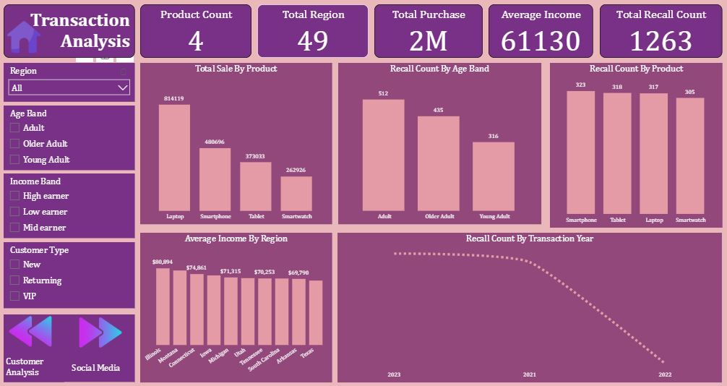
DASHBOARD OVERVIEW
Key Insights
Transaction Analysis Dashboard
Laptop and smartphone sales dominate revenue, making these products critical to protect from recall-related and reputational risks.
Adult and older adult customers account for most recalls, increasing churn risk among Client’s most economically active segments.
Smartphones show the highest recall frequency, indicating elevated reputational risk for a high-visibility product category.
Consistently high regional incomes suggest strong customer expectations and low tolerance for product or service failures.

Slide 8
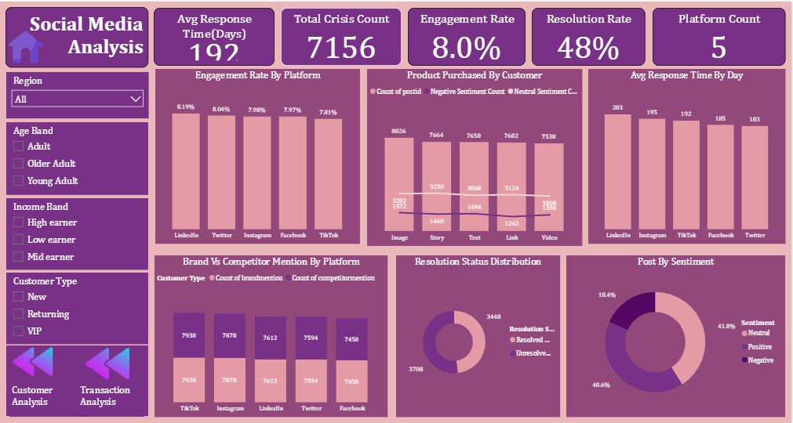
DASHBOARD OVERVIEW
Key Insights
Social Media Analysis Dashboard
High engagement across platforms increases brand visibility but also amplifies the impact of negative incidents if not managed quickly.
Visual content (images and stories) drives stronger customer interaction, making it both a powerful marketing tool and a high-risk channel during crises.
Brand and competitor visibility are closely matched, meaning reputational issues can quickly shift attention toward competitors.
A high number of unresolved issues indicates operational gaps that may prolong negative sentiment and weaken customer trust.

Slide 9
RECOMMENDATIONS
Insight Focus | Recommendation | Impact
Customer concentration in a few regions increases reputational risk. | Establish region-specific crisis playbooks for high-density markets, including predefined messaging, escalation contacts, and local service partners. | Faster containment of regional crises and reduced spillover into national brand damage.
Balanced age demographics amplify reputational reach | Adopt multi-channel crisis communication, tailoring tone and platform choice by age group (e.g., concise updates on Twitter, detailed explanations on Facebook and LinkedIn). | Ensures clarity and trust across generations, preventing miscommunication-driven backlash.
High-income customers are more sensitive to service failures | Introduce a priority support tier for high-income and premium customers, including faster response SLAs and proactive follow-ups after incidents. | Reduces churn among high-value customers and protects lifetime value.

Slide 10
RECOMMENDATIONS
Insight Focus | Recommendation | Impact
Strong returning customer base increases trust risk | Implement post-crisis loyalty recovery actions such as personalized apologies, service credits, or extended warranties for affected returning customers. | Converts potential churn events into trust-building opportunities.
Mid- and high-income dominance amplifies online escalation | Deploy real-time social listening alerts specifically for high-influence users (large follower counts or high influencer scores). | Early detection of high-impact complaints before they escalate publicly.
High-value, geographically concentrated customer base | Create a centralized crisis command team with 24/7 monitoring during recall periods, supported by regional execution teams. | Faster, coordinated responses that protect market position during high-risk events.
Laptop and smartphone sales dominate revenue | Introduce pre-release quality stress testing and phased rollouts for laptops and smartphones to detect defects before mass distribution. | Reduces recall probability for revenue-critical products.

Slide 11
RECOMMENDATIONS
Insight Focus | Recommendation | Impact
Adult and older adult customers account for most recalls | Adult and older adult customers account for most recalls | Improves customer experience and reduces frustration-driven sentiment.
Smartphones show the highest recall frequency | Smartphones show the highest recall frequency | Enabe earlier corrective action and limits reputational exposure.
High regional income implies low tolerance for failure | Adopt premium service standards nationwide, not just in select regions, to ensure consistent experience for high-expectation customers. | Prevents regional inconsistencies from triggering dissatisfaction.
Recall decline trend requires validation | Cross-validate recall trends with sentiment and complaint volumes to confirm whether improvement is real or underreported. | Prevents false confidence and supports evidence-based quality decisions.

Slide 12
RECOMMENDATIONS
Insight Focus | Recommendation | Impact
High engagement increase crisis amplification | Define rapid response SLAs by platform, prioritizing high-engagement channels for faster intervention | Limits viral spread of negative incidents
Visual content is high-impact but high-risk | Pause or moderate promotional visual content during active crises, replacing it with transparent informational updates. | Prevents tone-deaf messaging and reputational backlash.
Slow response times escalate dissatisfaction | AI-assisted triage and auto-acknowledgement to immediately respond while human agents resolve issues. | Reduces perceived response time and customer frustration.

Slide 13
RECOMMENDATIONS
Insight Focus | Recommendation | Impact
Brand and competitor visibility are closely matched | Run reputation reinforcement campaigns immediately after crisis resolution to reclaim narrative dominance. | Prevents competitors from capitalizing on reputational gaps.
High unresolved issue count weakens trust | Implement mandatory resolution closure tracking, with unresolved cases escalated automatically after defined thresholds. | Improves resolution rates and accountability.
Persistent negative sentiment signals vulnerability | Establish weekly sentiment review meetings combining marketing, support, and product teams to address root causes. | Moves crisis management from reactive to preventive.

Slide 14

Thank you
Omolola Bankole
omolola.fbankole@gmail.com

